Slide 1
Document-Reading Virtual Assistant
Resonance Labs

Slide 2
Problem Statement
Develop a prototype for a Virtual Assistant (VA) capable of:
Document Processing: Loading, reading, and understanding documents in various formats (e.g., .txt, .docx, .pdf).
Natural Language Understanding: Interpreting the content of these documents, summarizing key points, and understanding the context.
User Interaction: Interacting with the user by fielding queries about the document's content and providing accurate answers.

Slide 3
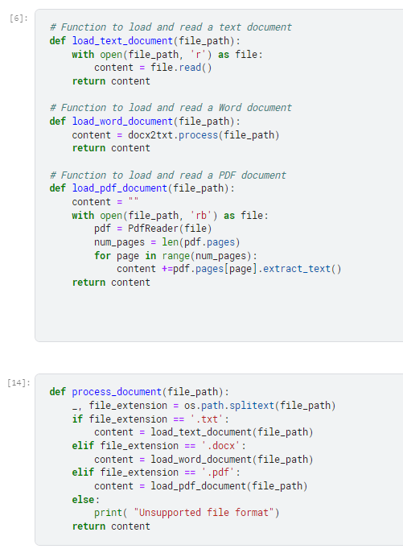
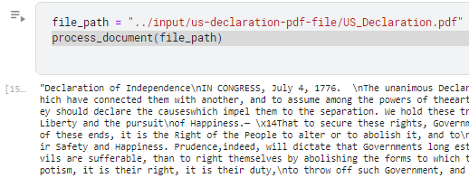
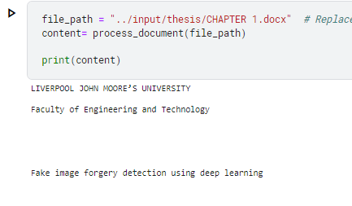
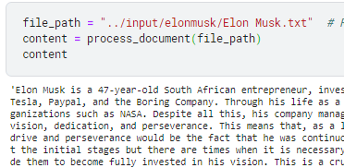
Document Processing

Slide 4
Basic NLP Approach for Implementing Question Answering System
Gather and Pre- process the data
Generate training data embedding
Store training data embedding
Generate question embedding
Match embedding response
Generate answer
Test the model

Slide 5
Approaches
Explored below five approaches:
Question Answering System Using Simple Split and Cosine Similarity (Naive Approach)
Question Answering System Using Word2Vec Embedding Technique
Question Answering System Using Glove Embedding Technique
Question Answering System with Fine-Tuned BERT Technique
Question Answering System with Hugging Face Pre-Trained Transformer

Slide 6
Text Used for Comparison
Life insurance is a legally enforceable contract between two parties both of whom are legally qualified to contract. It is therefore, necessary that the terms and conditions of the agreement must be suitably documented in a manner that would make it clear that both parties to the contract are Ad- idem i.e., of the same mind. Ad-Idem means that both the parties understand the same thing in the same sense or agree on the same subject. There must be a consensus or Ad-Idem between the parties to the contract.This is possible provided all the terms and conditions, rights and duties - privileges and obligations are properly documented in terms that can be interpreted in a court of law. Between two human beings, sometimes silence means acceptance. But as the insurer is a legal personality entitled to a contract verbal discussion between parties to the contract is not possible and hence there is a need for documentation.Insurance is also a contract of utmost good faith and enforced only in the distant future. It is therefore necessary that the declarations made by both parties should be put in black and white for future reference. Any suppression, willful, and material shall make the contract void. The insured, therefore, must declare all that he knows about himself, his health, and his financial status in answering questions contained in the proposal form and other ancillary documents which may be required by the insurer.Age is an important factor in deciding the quantum of premium against a policy. The document proving the age, i.e. age proof must be reliable and the insured has to undertake its truthfulness.Non-standard age proofs are those which are comparatively less reliable and therefore the insurer accepts them with a pinch of salt. In other words, the insurer takes certain precautions before accepting such age proofs as final.Proof of income is the document that may become necessary whenever the sum proposed is very high. Normally a sum proposed which is seven to eight times of the declared income is acceptable for insurance. But proposals do come to the insurer when the known source of income of the proposer is much less compared to the amount of insurance desired. A service holder normally does not face this problem as his sources of income are verifiable.In case of business people, the assessed income is at times much less compared to what is a desirable income for the amount of insurance desired. In such cases the insurer at times calls for assessed income tax returns, or Chartered Accountant’s certificate etc. Such precautions are necessary to eliminate the possibility of moral hazard.Policy Contract is the policy document is a detailed document and it is the Evidence of the insurance contract which mentions all the terms and conditions of the insurance. The insured buys not the policy contract, but the right to the sum of money and its future delivery. The insurer on its part promises to pay a sum of money, provided of course the insured keeps its part of promise of paying the installments of premium as scheduled.The pre-amble to the insurance contract makes the above statement clear and states that this policy is issued subject to the conditions and privileges printed on the back of the policy. The endorsements placed on the policy shall also be part of the policy and it also makes a reference to the proposal form saying that that the statements given in the proposal form are the basis of the contract.The schedule which is printed on the policy document identifies the office which has issued the policy. It states the name of the policyholder, the date of commencement of the policy, an identification number of the policy called policy number. This number is extremely useful for making any reference to the insurer relating to this policy. This shall avoid needless delay.Beneficiary’s name is also mentioned along with address.It is necessary to check that it is correct and any mistake should be immediately pointed out for correction. A mistake in the address may misdirect the premium notices and any other future correspondence. It also states the name of the nominee and the date upto which premium has to be paid. The schedule goes on to mention, the type of policy, on the happening of which, the sum assured is payable and to whom it is payable. It of course also mentions when and how long the premium is to be paid.The policy document is signed by an official of the insurer and dated and stamped as per the provision of the Stamp Act to make it a completely legally enforceable document.An assignment of a policy in favour of another person or institution can be effected by an endorsement on the policy. Re-assignment can also be done by a subsequent endorsement on the same policy.As a nomination is automatically cancelled due to an assignment, after re-assignment, it is necessary to make a fresh nomination.In Duplicate policy a policy document is a valuable document and can be used for mortgage etc. Loss of policy document does not absolve the insurer from the liability of payment of policy proceeds when the claim arises. The claim can be settled on the claimants, furnishing an indemnity bond jointly with one surety.If a policy is irrevocably lost, a duplicate policy can be issued, after following a certain procedure like the insurer satisfies itself of the circumstances leading to loss and being so satisfied the insurer insists upon an advertisement in a news paper, production of an indemnity bond and payment of policy preparation charges and there after a duplicate policy is issued.Generally nomination is made at the time of taking a policy. In case it is not done, it is possible to make nomination subsequently by an endorsement on the policy. It is also possible to change a nomination subsequently by an endorsement. After marriage, such change in nomination is normally required.Life insurance being a legally enforceable contract, needs to be documented with details of the rights and obligations of the parties to the contract. Proposal form duly filled in and signed by the proposer is the first document which forms the basis of the contract.Every time, the insured pays the premium, he receives a premium receipt. The premium needs to be paid in time, non- payment of premium leads to policy-lapses. Re-instatement of the cover is called revival of the policy.If the policy is not revived, the policy can become a paid up policy for a reduced sum assured under certain conditions.The policy document mentions in detail all the rights and obligations of the policyholder. The agent is advised to explain the various provisions of the policy to the policyholder.The wordings in the policy document are of technical nature and hence the need for explaining. If there are certain endorsements on the policy, that need to be explained too.It needs to be explained that the policy is a valuable document and needs to be kept in safe custody and in the knowledge of the close relatives.

Slide 7
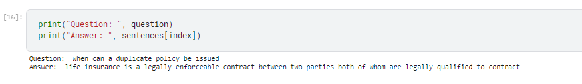
Simple Split and Cosine Similarity (Naive Approach)
Cosine similarity is one of the metrics to measure the text-similarity between two documents irrespective of their size in Natural language Processing. A word is represented in a vector form. The text documents are represented in n-dimensional vector space. Mathematically, the Cosine similarity metric measures the cosine of the angle between two n-dimensional vectors projected in a multi-dimensional space. The Cosine similarity of the two documents will range from 0 to 1. If the Cosine similarity score is 1, it means two vectors have the same orientation. A value closer to 0 indicates that the two documents have less similarity.
Results
BOW representation did not do very well and retrieved the wrong answer since it is looking for exact word match.

Slide 8
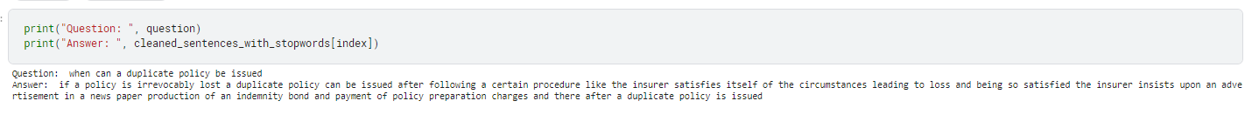
Word2Vec
Word2Vec is a natural language processing method for word representation.
It analyzes large collections of text to find word patterns.
Words are understood in the context of neighboring words.
Relationships between words are captured using numerical vectors.
Word vectors are created based on word co-occurrence patterns.
Similar words have similar vector representations.
Word2Vec enhances search engines and machine learning models.
Enables accurate search results and improved performance.
Helps computers grasp word meanings and relationships.
Results

Slide 9
GloVe Embedding
GloVe (Global Vectors for Word Representation) is a word embedding technique used in natural language processing to represent words as dense vectors in a high-dimensional space.
GloVe starts by creating a co-occurrence matrix that captures how frequently words co-occur with each other in the given text corpus.
It then applies matrix factorization techniques to this co-occurrence matrix. The goal is to factorize the matrix into two smaller matrices, such that their product approximates the original co-occurrence matrix.
The resulting factorized matrices are used to compute word vectors. Each word is represented by a vector in the high-dimensional space, where the dimensions capture the relationships between words based on their co-occurrence patterns.
By training on a large corpus, GloVe learns to capture both the global context (how words relate to each other across the entire corpus) and the local context (how words relate to their neighboring words).
Results

Slide 10
BERT-Large-Uncased-Whole-Word-Masking-Finetuned
BERT (Bidirectional Encoder Representations from Transformers) is a technique used in natural language processing to enhance the performance of the BERT model on specific tasks. BERT is a pre-trained language model that has been trained on a large corpus of text to learn general language representations.
BERT-Large-Uncased-Whole-Word-Masking-Finetuned-SQuAD is a variant of the BERT model that has been fine-tuned on the SQuAD dataset for question answering.
It uses a larger BERT model, ignores capitalization, masks whole words during pre-training, and is specifically trained to answer questions within a given context.
"Whole Word Masking" means that instead of masking individual characters, whole words are masked. This helps BERT to better capture the relationships between entire words.
This variant is effective for question-answering tasks due to its extensive pre-training and fine-tuning on the SQuAD dataset.
**SQuAD stands for the Stanford Question Answering Dataset

Slide 11
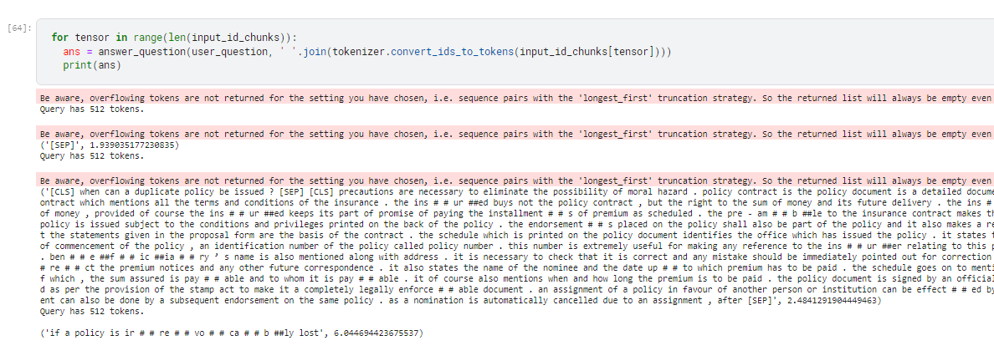
Bert Technique
Advantage
Improved Performance on Question Answering
Transfer learning capability
Comprehensive Language Understanding
Results

Slide 12
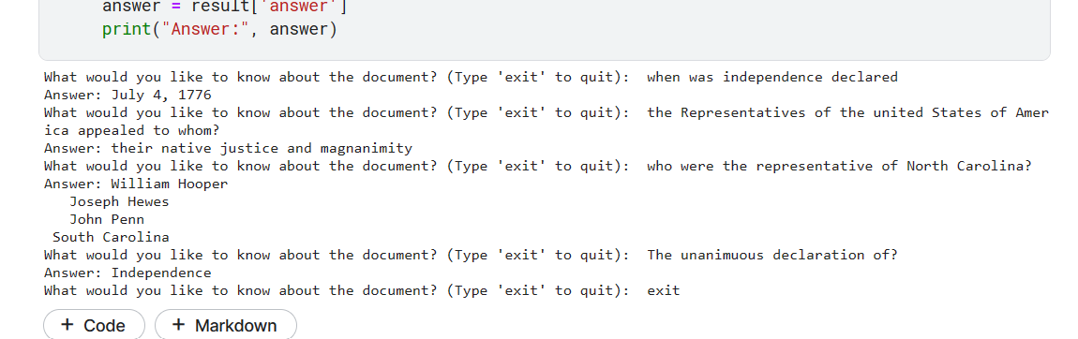
Hugging Face Transformer Pre-Trained Model
Hugging Face's pre-trained transformer models for question answering are fine-tuned on question-answering datasets like SQuAD. These models leverage transfer learning and have achieved state-of-the-art performance. By providing an input context and question, these models can generate accurate answers or identify relevant text spans within the context. They are easy to integrate and widely accessible, making them a valuable tool for question-answering tasks.
Advantages
Easy to implement
Transfer Learning capabilities
Supports different languages
**https://huggingface.co/models?pipeline_tag=question-answering
Results

Slide 13
Challenges
Bert is a highly effective model for question-answering tasks, but it has a limitation of handling only 512 tokens at a time. This becomes problematic when dealing with longer documents. To address this limitation, I developed the "expand_split_sentences" function. This function splits and expands sentences within the document, creating paragraphs with fewer than 512 tokens. Each paragraph is then converted into a data frame. Since multiple data frames may contain the correct answer, we determine the best answer by identifying the data frame with the highest start score
import gensim fails on Windows with numpy 1.19.5
iopub message rate exceeded. the notebook server will temporarily stop sending output to the client in order to avoid crashing it

Slide 14
Future work
Difficult to work with specially formatted documents. E.g. My CV
Implement a CDQA model for handling multiple files
Deploy a web model to have use inputs for the choice of model and also questions
Creating a virtual environment

